Slide 1
Spark Streaming Across MSFT
Shared Data

Slide 2
Outline
The Bet on Spark Streaming
Mobius Project
Add C# Binding
Presto Project
Bing Search Merge Log as Reference App

Slide 3
The Bet on Spark Streaming
Why Spark Streaming?
One programming model covers streaming, batch and interactive
RDD, DataFrame, SparkSQL
Fault tolerant
Recover from the checkpoint, including Kafka offsets
Strong community momentum
Practice and lesson sharing in the community
Healthy feedback loop for new releases

Slide 4
Mobius Project
Goal
Add C# binding to Apache Spark
Motivation
Teams can share the legacy C# libraries
C# developers can build Spark applications in C#
Design Approach
Reuse PySpark and SparkR design and implementation as appropriate
Engineering Approach
Early on, looped in Spark committers
Open Source, MIT license, hosted at github (https://github.com/Microsoft/Mobius)
Adopt best engineering practices among open-source projects at github

Slide 5
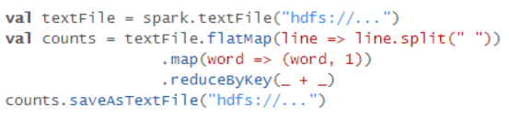
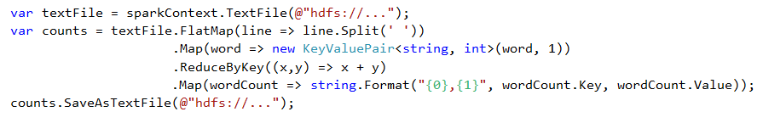
Mobius Word Count example
Scala
C#

Slide 6
Mobius Internal Architecture
Reuse PySpark and SparkR design and implementation
Workers
JVM
SparkExecutor
CSharpWorker
2
CLR
Driver
TCP fast-loop
C# App
(aka Driver)
CLR
SparkContext
1
JVM
JVM
SparkExecutor
CSharpWorker
CLR
TCP fast-loop
TCP fast-loop
JVM
SparkExecutor
CSharpWorker
CLR
Scala/JVM component
TCP fast-loop
C# component
Notes:
Driver-side interop uses Netty server as a proxy to JVM – similar to SparkR
Worker-side interop reuses PySpark implementation
CSharpRDD inherits from PythonRDD reusing the implementation to launch external process, pipe in/out serialized data
Sockets provide point-to-point, two-way communication between two processes. Sockets are very versatile and are a basic component of interprocess and intersystem communication. A socket is an endpoint of communication to which a name can be bound. It has a type and one or more associated processes.

Slide 7
JVM
Spark
Context
(Spark)
RDD
(Spark)
CSharpRDD
create
5
8
Use jsc & create JRDD
13
Called by sparkclr-submit.cmd
CSharpRunner
Launches Netty server creating
proxy for JVM calls
CSharpBackend
1
Invokes JVM-method
to create context
4
7
Invokes JVM-method
to create RDD
SparkContext has
reference to SC in JVM
2
Driver
(user code)
Init
SparkContext
3
Launches C#
sub-process
Invokes JVM-method
to create C#RDD
create RDD
12
6
9
Java/Scala component
RDD
RDD has reference
to RDD in JVM
C# operation
create
PipelinedRDD
C# component
10
11
All components will be SparkCLR contributions
except for user code and Spark components

Slide 8
Mobius Worker-side (RDD)
CSharpRDD extends PythonRDD for code reuse
CSharpWorker is needed only for C# UDF, such as C# lamda
CSharpRDD
CSharpWorker
2
Fork C# Worker
1
Serialized data and C# UDF
Spark calls
Compute()
3
TCP fast-loop
Serialized data
TCP fast-loop
4
Scala/JVM component
C# component

Slide 9
Mobius Performance Considerations
One CSharpWorker process for each JVM executor process
PySpark forks a Python process for each task thread in JVM executor process
New C# option of one thread for each task thread in JVM executor process
C# operations are pipelined when possible
Map & Filter RDD operations in C# need data to be passed from JVM to C#, incurring the cost of serialization and deserialization
C# operations are pipelined when possible to minimize data passing
DataFrame operations without C# UDFs do not require CSharpWorker
Same execution plan optimization and code generation in Spark Core
Perform the same as Scala applications
Notes:
Persistence is handled by JVM - checkpoint/cache on a RDD impacts pipelining for CLR operations

Slide 10
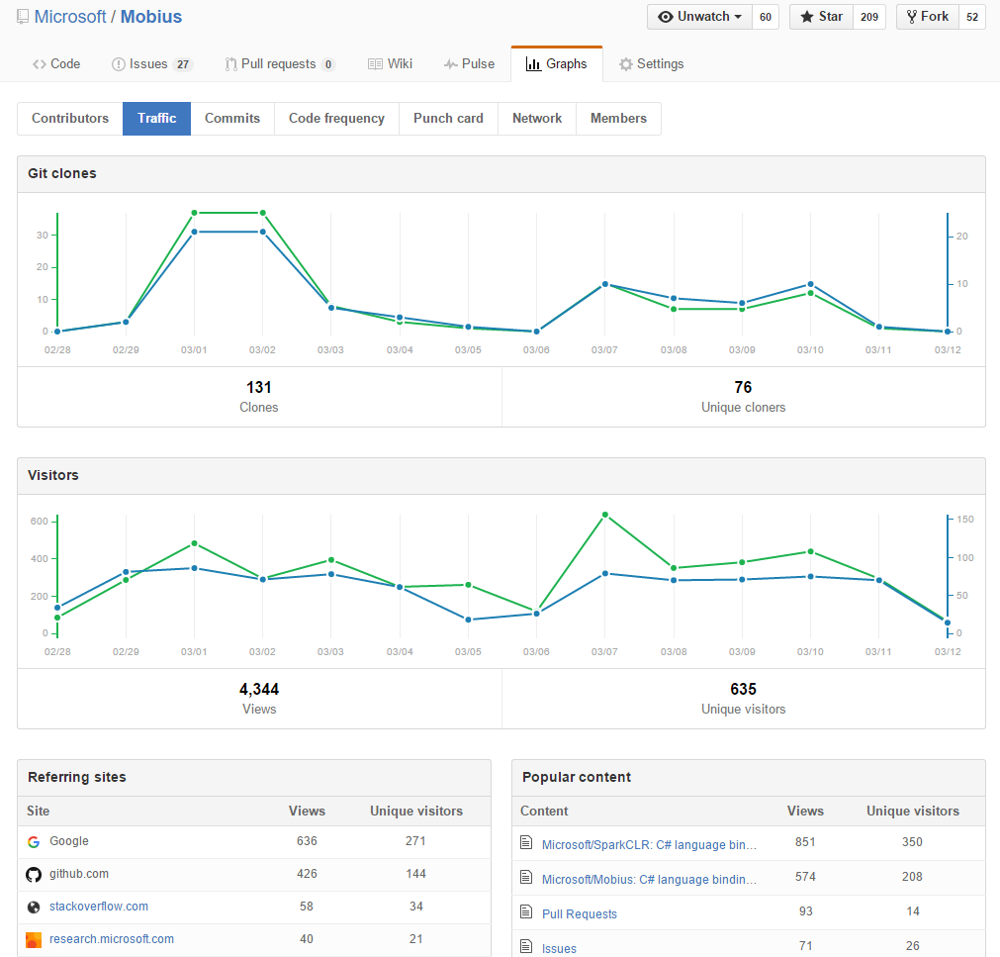
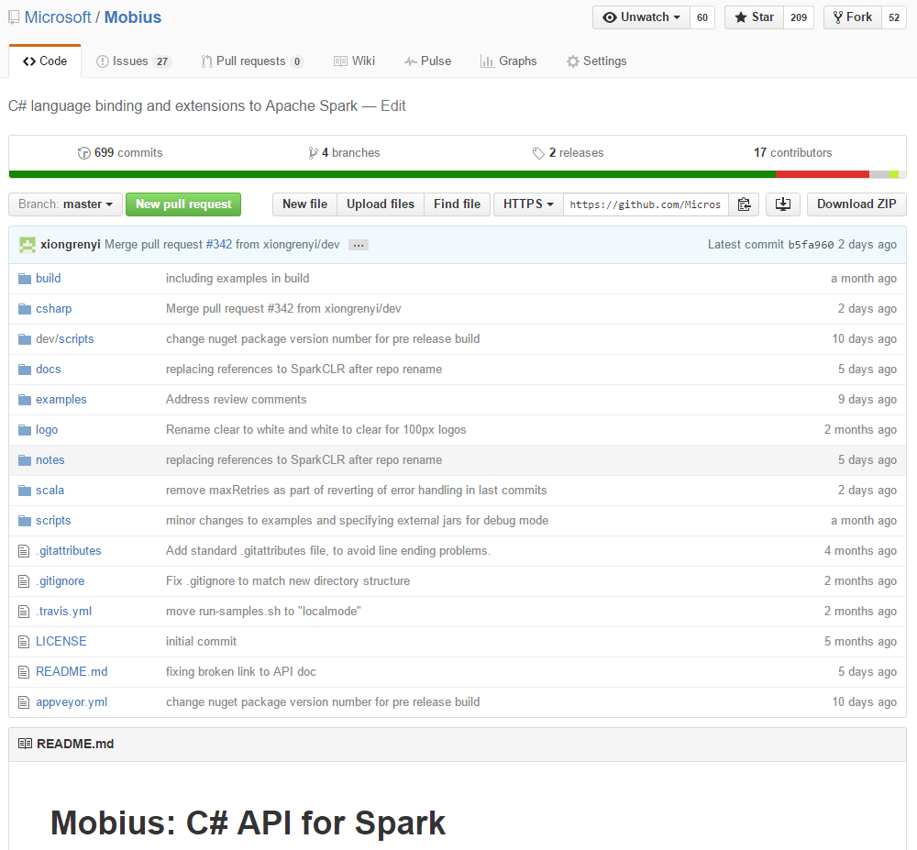
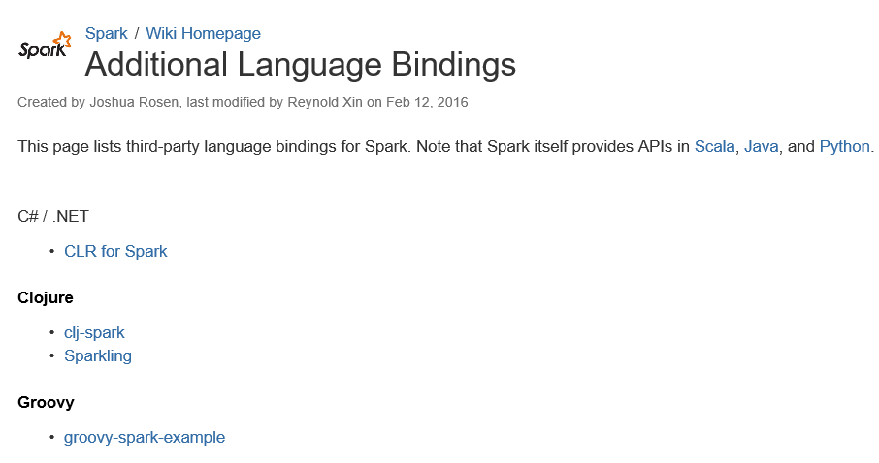
Mobius@github
Apache Spark Wiki references http://github.com/Microsoft/Mobius
699 commits, 2 releases, 17 contributors (including 6 devs from Shared Data)
Last two weeks - 131 clones, 4K views

Slide 11
Presto Project
Goal
Produce near real-time Bing Search Merge Log with Spark Streaming + Mobius
Motivation
A reference application, at Bing scale, in production, to prove platform readiness
Design Approach
Use UpdateStateByKey() to merge logs within a time window
Enhance Spark Streaming by extending KafkaRDD
Engineering Approach
Continuous validation of Presto pipeline in both Standalone and Yarn clusters
Pounding the pipeline with Bing query volume
Share Spark Streaming enhancement in Mobius project, for Spark community feedback

Slide 12
Presto Pipeline
Raw Events
Databus
Event Merge Pipeline
Databus
1
2
3
4
N-minute App-Time Window10
Edge
Kafka
E
E
E
E
Kafka
UI-Layout
U
U
U
U
Merged
Event
Click
C
C
C
C

Slide 13
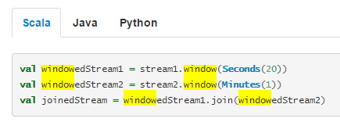
UpdateStateByKey to join DStreams
Why not Stream-stream joins?
Application time is not supported in Spark 1.6. Window Operations is based on wall-clock.
Solution – UpdateStateByKey
UpdateStateByKey takes a custom JoinFunction as input parameter;
Custom JoinFunction enforces time window based on Application Time;
UpdateStateByKey maintains partially joined events as the state
Batch job 1
RDD @ time 1
B
Batch job 2
RDD @ time 2
Batch job 3
RDD @ time 3
Edge Event DStream
Click Event DStream
UpdateStateByKey
A
State DStream
C

Slide 14
Dynamic Repartition for Kafka Resilience
Kafka issues
Unbalanced partition – one Kafka partition has a lot more data
Insufficient partitions - every Kafka partition has a lot more data at peak time
Solution – Dynamic Repartition
Repartition data from one Kafka partition into multiple RDDs
Configurable repartition threshold
Engaging Spark committer, Tathagata Das (TD)
Incoming data – edge events from Ch1d, 2-minute interval
Incoming data at 2-minute interval | Before Dynamic Repartition | After Dynamic Repartition
Average Processing Time
3 minutes and 10 seconds
1 minute and 24 seconds

Slide 15
Q&A
Notes:
Raghu Ramakrishnan <raghu@microsoft.com>

